Slide 1

Postpartum Depression (PPD) Prediction System (AI-Powered Risk Assessment & Conversational Screening)
CREATED BY NATALIA GORDON & GOLDA Krishtalev

Slide 2

Agenda
Introduction & Problem
Solution Overview
Main System Actions
Project Overview
Key Features
Data & Data Processing
System Architecture
ML Model & AI Agents
Demo & UI
Ethics, Impact & Future

Slide 3

AI-Powered Postpartum Depression Risk Prediction & Conversational Screening

Slide 4

INTRODUCTION & PROBLEM
Postpartum depression is a common and significant condition, but is under-recognized in maternity wards. The problem occurs during postpartum hospitalization, a critical phase when there is an opportunity for early detection, but in practice, limited or no emotional assessment is performed.
The main victims are the mothers who are not diagnosed and referred for treatment in time, as well as the patient's family. The medical staff and the system also suffer from overload, lack of tools for detecting risk, and missed significant diagnoses.

Slide 5

INTRODUCTION & PROBLEM
The problem is significant due to the burden on the staff, lack of time for in-depth conversations, and the absence of a system that integrates medical and emotional data in real time, which leads to a deterioration in the quality of care, the experience of the mother, and a health risk in the short and long term.

Slide 6

Solution Overview
In this project, we developed an AI-powered decision-support system that combines clinical and psychosocial data, explainable machine learning and conversational EPDS chatbot.
Target audience:
Main user: Medical staff in the maternity ward, community gynecologists and family doctors
Secondary user: The woman in labor.
It is important to emphasize – this is not a diagnostic system, but a tool that assists in the early identification of risk, to enable timely referral and support!

Slide 7
Main system actions
Calculating a personal risk score for postpartum depression
Adjusting questions according to risk level (for further development)
Data integration with EPDS, clinical, psychosocial and emotional information
Prioritizing mothers according to risk level (for further development)
Generating alerts and recommendations for the department staff
Creating an update interface for the family doctor and the gynecologist in the community after discharge for the purpose of continuity of care and follow-up (for further development)

Slide 8

Desired result
Early identification of mothers at risk, timely intervention during hospitalization, and ensuring continuity of care even after discharge to an outpatient setting.

Slide 9
Project Overview
This project is an AI-powered Postpartum Depression (PPD) Risk Prediction System that combines:
- Machine Learning Models (XGBoost & Random Forest) for accurate risk assessment
- SHAP Explainable AI for transparent, interpretable predictions
- Algorithm questioning for medical staff (Q&A)
- EPDS Conversational Agent for natural language screening
- Interactive Gradio Interface for easy-to-use clinical assessment tools
- Domain Knowledge Integration* for medically-informed risk adjustments
The system helps healthcare professionals and researchers identify women at risk for postpartum depression by analyzing demographic, clinical, psychiatric, and psychosocial factors.

Slide 10
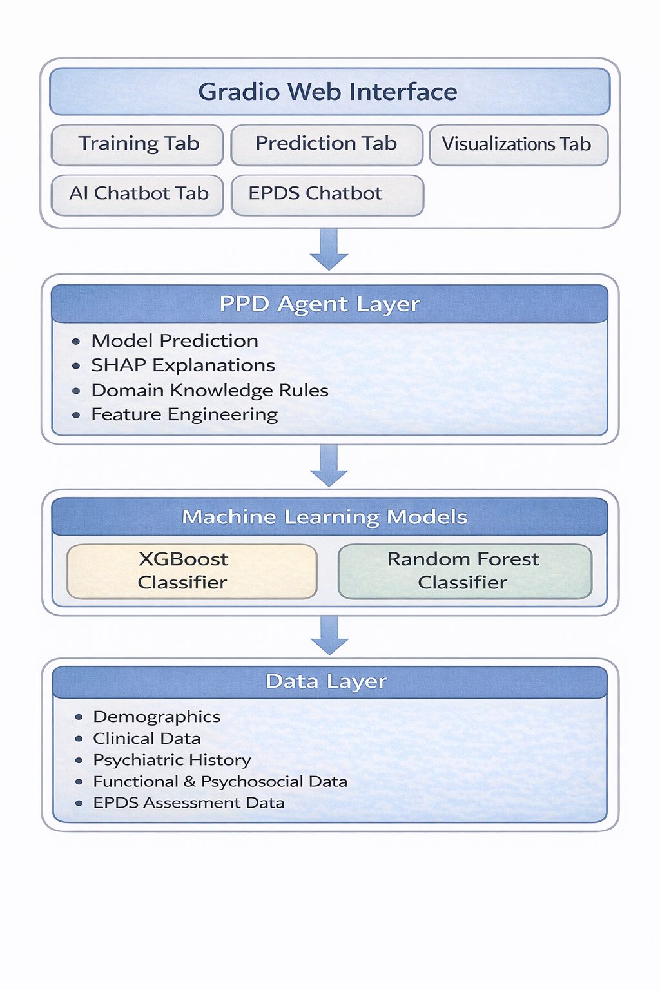
System Architecture
This system was developed as part of PPD Prediction Prototype, focusing on:
- Machine learning model development
- Explainable AI (XAI) implementation
- Natural language processing
- Clinical decision support systems
- User interface design

Slide 11
Key Features
3. EPDS Conversational Agent
- LangChain-powered natural language interaction
- Hebrew language support for patient conversations
- Sentiment analysis using LLM-based distress detection
- Natural language understanding for patient responses
- Automatic EPDS score calculation
4. Algorithm questioning for medical staff (Q&A)
- LangChain-powered natural language AI Chatbot
- Based on model predictions and SFAP explanations
1. Dual ML Algorithm Support
- XGBoost Classifier with hyperparameter optimization
- Random Forest Classifier with default parameters
- Automatic algorithm selection and comparison
- Model persistence and retraining capabilities
2. Explainable AI (XAI)
- SHAP (Shapley Additive Explanations) integration
- Feature importance visualization
- Personalized risk explanations
- Waterfall-style SHAP plots for individual predictions

Slide 12
Key Features
4. Domain Knowledge Integration
- Medical rule-based adjustments
- EPDS score integration
- Risk stratification based on clinical factors
- Context-aware probability corrections
5. User-Friendly Interface
- Gradio web interface with tabbed navigation
- Real-time predictions
- Interactive visualizations
- Model training controls
- Agent chat interfaces (General AI & EPDS)
6. Comprehensive Visualizations
- Target distribution plot
- Feature distributions by target class
- Confusion matrix
- ROC curve with AUC score
- Prediction probability distributions
- Correlation heatmaps
- SHAP summary plots​

Slide 13
Data & Data Processing
The system uses a comprehensive dataset combining multiple sources:
Data Sources:
1. Demographics.csv - age, marital status, SES, population, employment
2. Clinical_data.csv - first birth, GDM, TSH, NVP, GH, mode of birth
3. Psychiatric_data.csv - depression/anxiety history, medication use, PPD target
4. Functional_Psychosocial_data.csv - sleep quality, fatigue, partner support, family support, domestic violence
5. EPDS_answers.csv - EPDS total scores and self-harm thoughts
Data Processing:
- Inner joins on patient ID across all tables
- Missing value handling - rows with missing values are dropped
- Target encoding - PPD column converted from "Yes"/"No" to binary (1/0)
- Feature engineering - Categorical encoding

Slide 14
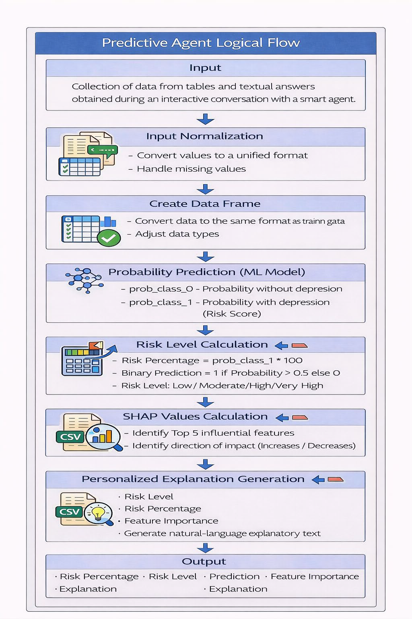
ML Models & AI Agents
Model Options
1. XGBoost/Random Forest Classifiers
- Hyperparameter optimization
- Evaluation metric: ROC AUC score
2. Model Performance
- Models are evaluated using:
- ROC AUC Score
- Confusion Matrix
- Classification Report
- Performance metrics are displayed in the interface

Slide 15
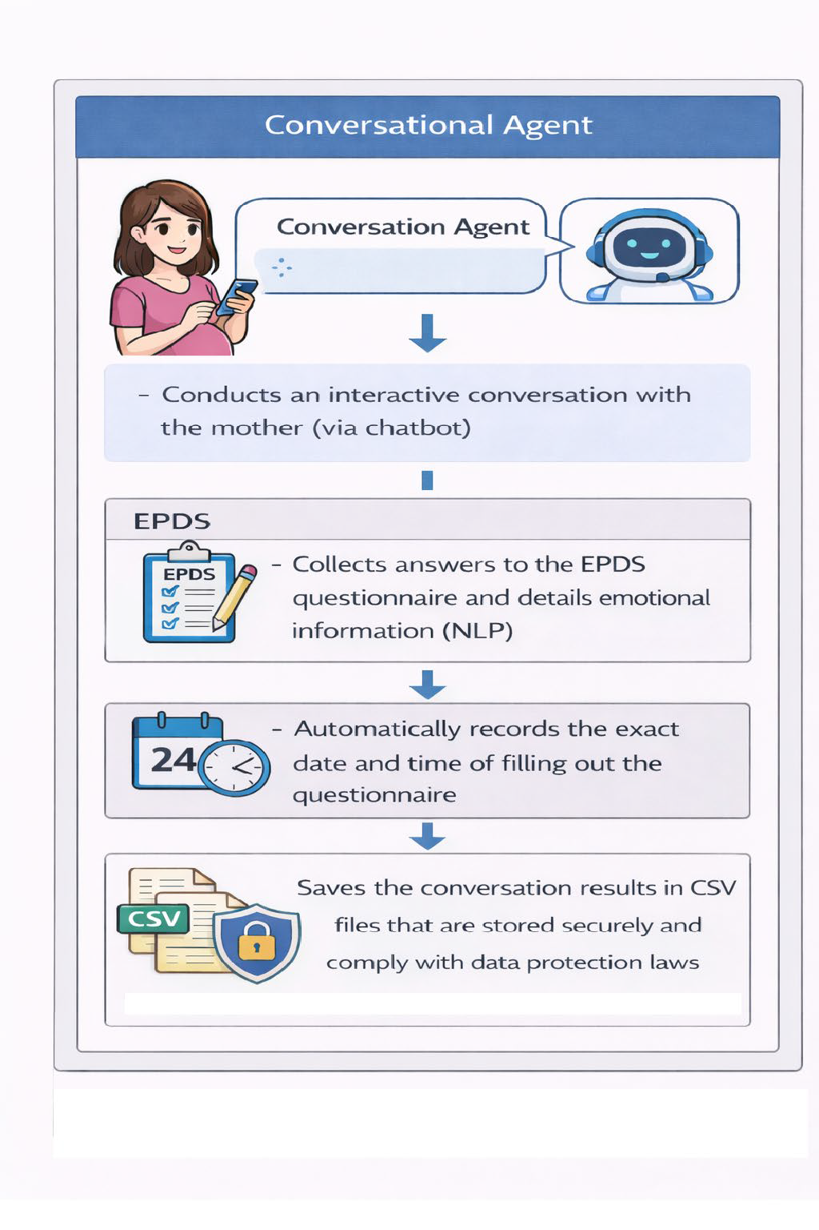
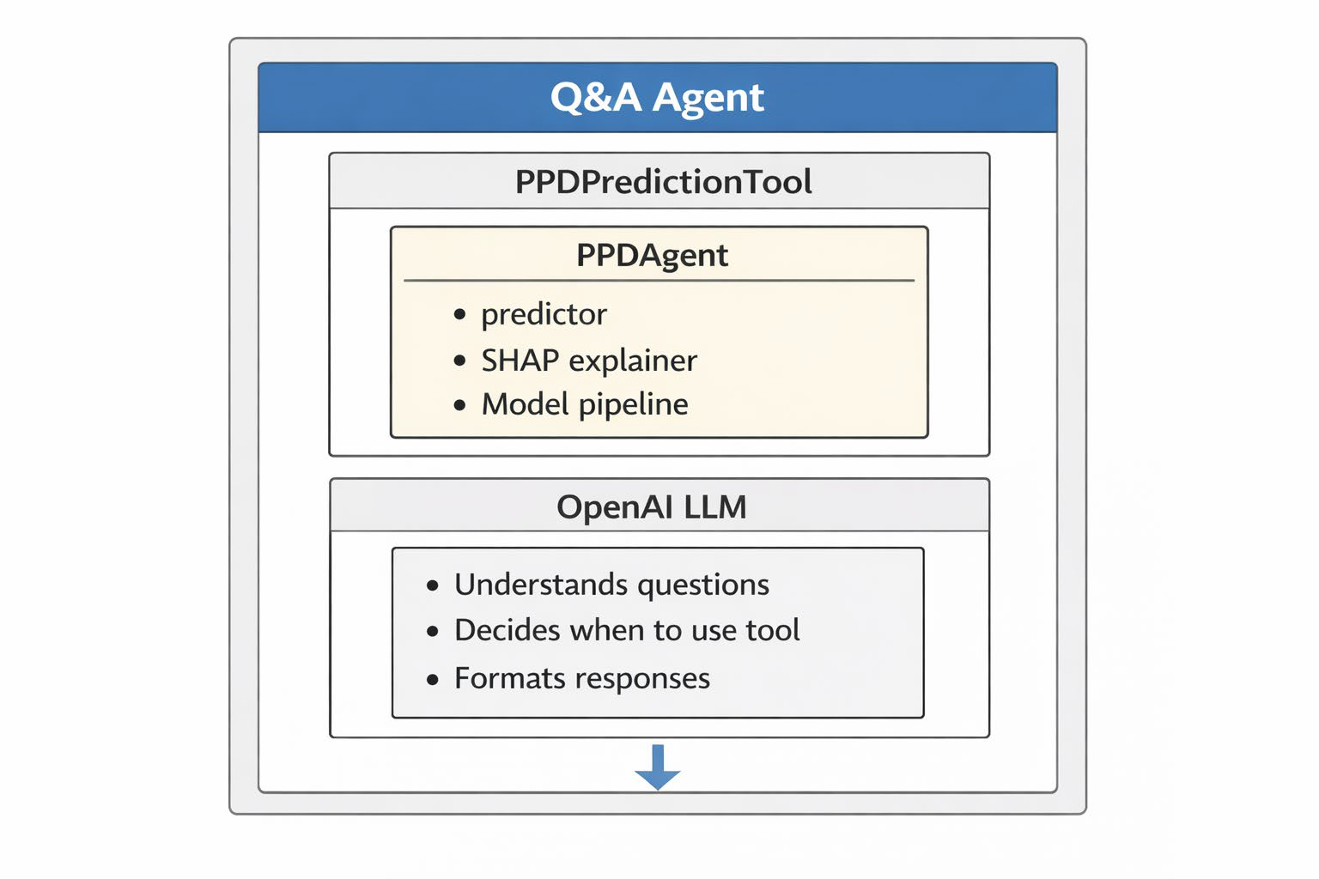
Q&A AGENTS

Slide 16
Demo & UI
1. Training Tab
- Algorithm selection (XGBoost/RF)
- Hyperparameter optimization toggle
- Training status and performance metrics
- Model save/load functionality
2. Prediction Tab
- Patient data input form
- Real-time risk prediction
- Risk percentage and level
- Top 5 feature importance
- Personalized explanation - SHAP visualization
3. Visualizations Tab​
- Target distribution​
- Feature distributions​
- Confusion matrix​
- ROC curve​
- Prediction distribution​
- Correlation heatmap​
- SHAP summary plots​
4. AI Chatbot Tab
- LangChain-powered conversational agent
- Natural language queries about PPD risk
- Example questions provided
- Integration with PPD prediction mode
5. EPDS Chatbot Tab
- EPDS conversational assessment
- Natural language patient interaction
- Sentiment analysis and distress detection
- Automatic scoring and risk assessment
- Crisis resource provision

Slide 17

Future Work
Planned actions for further implementation:
Adjusting questions according to risk level
Prioritizing mothers according to risk level
Creating an update interface for the family doctor and the gynecologist in the community after discharge for the purpose of continuity of care and follow-up
Planned Improvements:
- Additional ML algorithms (SVM, Neural Networks)
- Real-time data streaming integration
- Multi-language support expansion
- Mobile app interface
- Electronic Health Record (EHR) integration
- Longitudinal risk tracking -
Clinician dashboard
- Patient portal
- Automated report generation
- API deployment

Slide 18

Thank you!
MEDICAL staff:
Prof. GALI Pariante
Dr. NOAM Shema,
Dr. DANIELLE Ben Ari
technological side:
Ms. NATALIA Gordon
Ms. GOLDA KrIshtAlEv

